Slide 1

Lecture5
Regula False Method

Slide 2
False position is another bracketing method based on a graphical insight
A shortcoming of the bisection method is that, in dividing the interval from x_{l} to x_{u} into equal halves, no account is taken of the magnitudes of f (x_{l}) and f (x_{u})
False position technique joins f (x_{l}) and f (x_{u}) by a straight line
The intersection of this line with the x axis represents an improved estimate of the root
The fact that the replacement of the curve by a straight line gives a “false position” of the root is the origin of the name, method of false position, or in Latin, regula falsi
It is also called the linear interpolation method

Slide 3
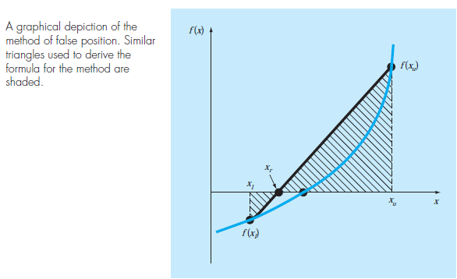

Slide 4
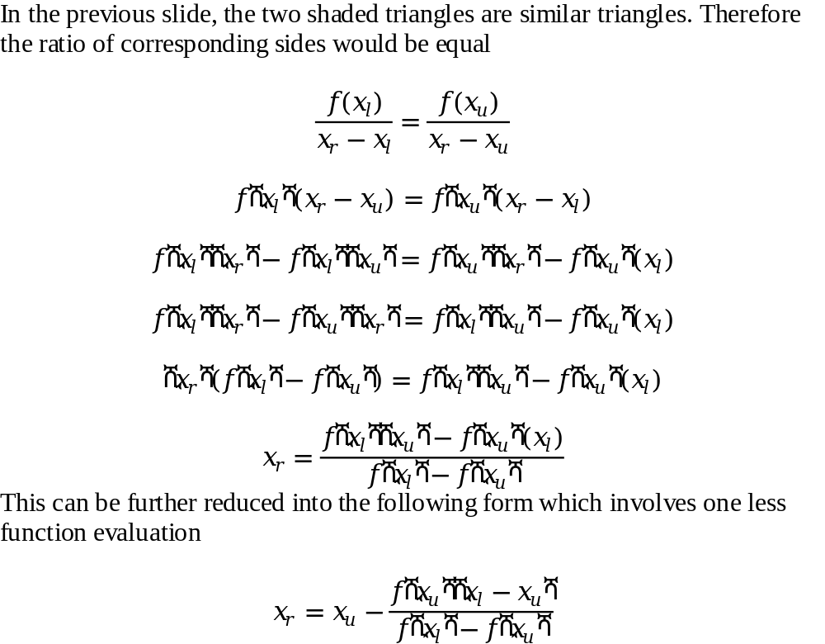
Derivation of the Method of False Position

Slide 5
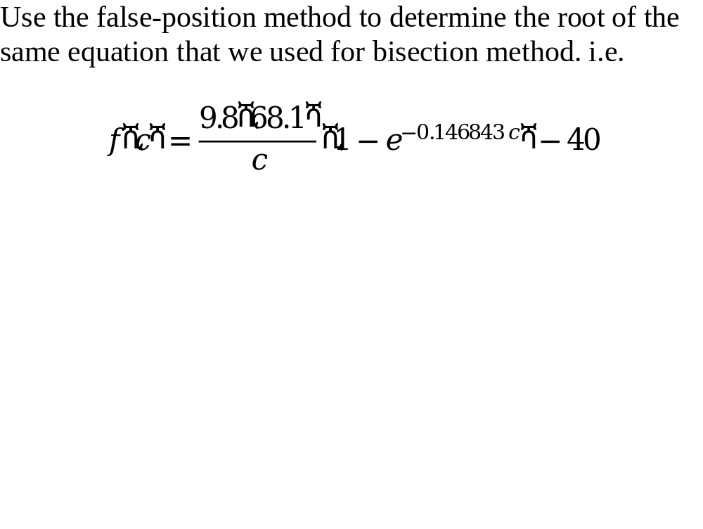
Example

Slide 6
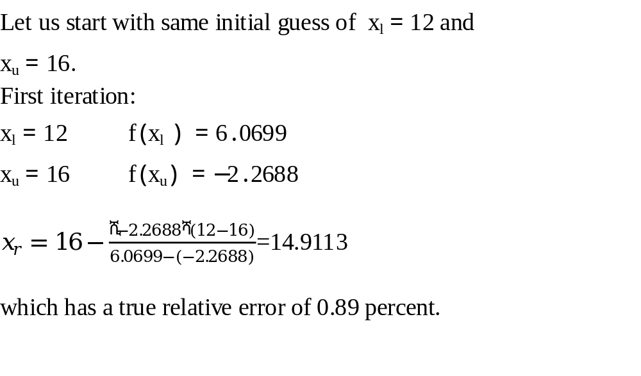

Slide 7
Properties
Usually false-position method would converge faster than the bisection method
There are cases where it performs poorly
The following example illustrates cases where bisection yields superior results

Slide 8
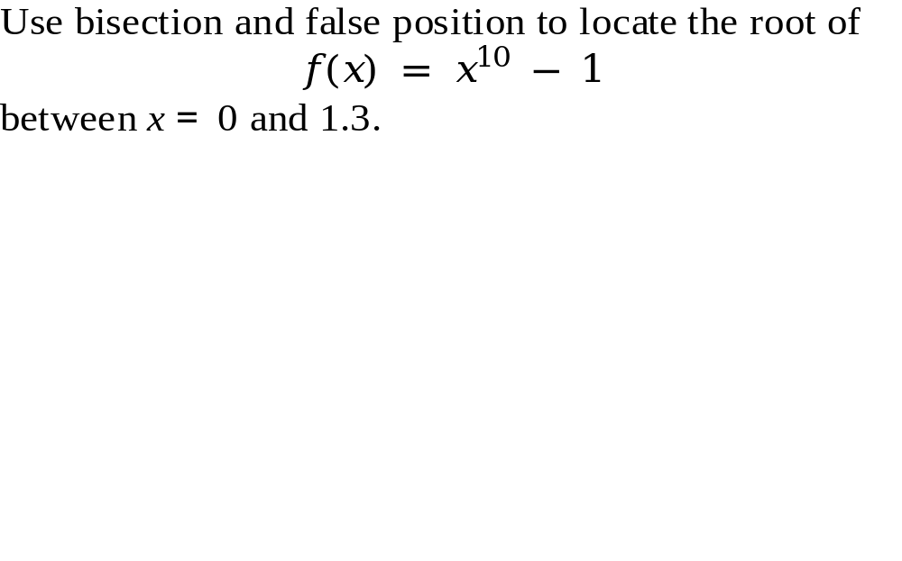
Example

Slide 9
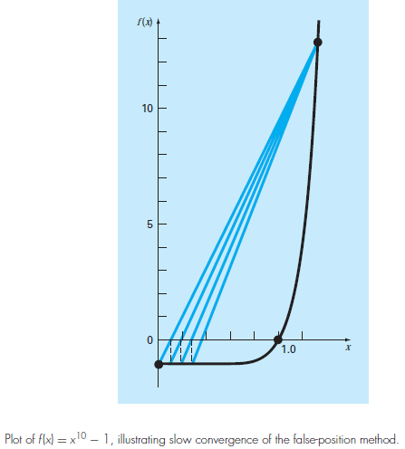

Slide 10
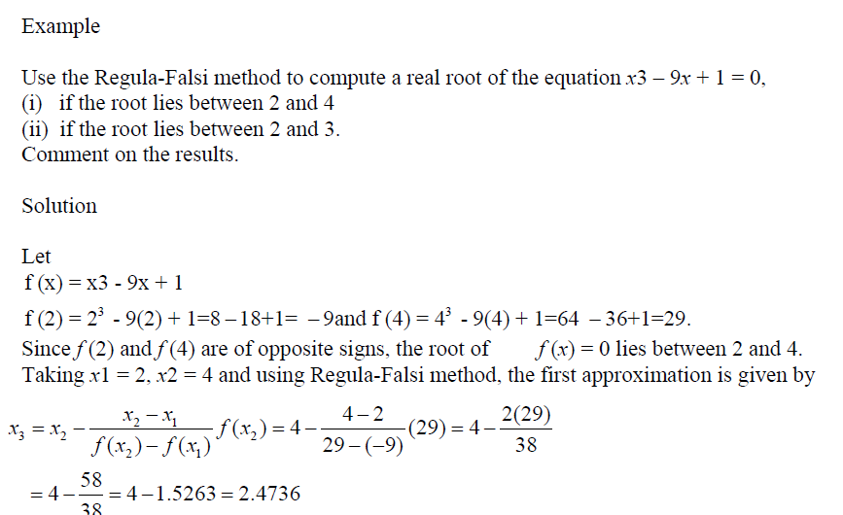

Slide 11
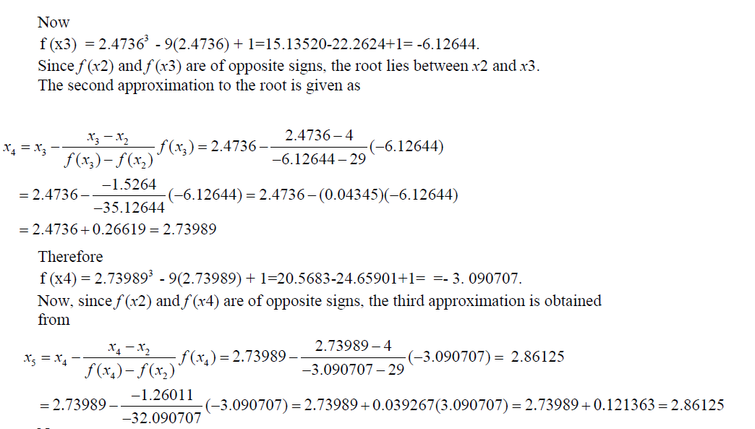

Slide 12
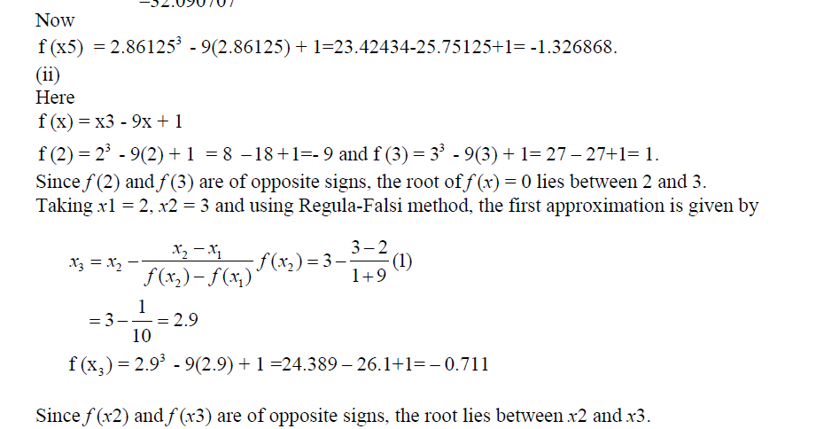

Slide 13
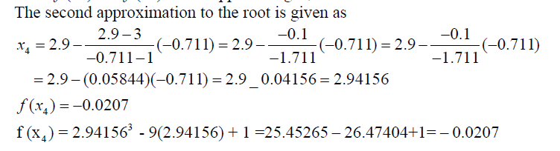
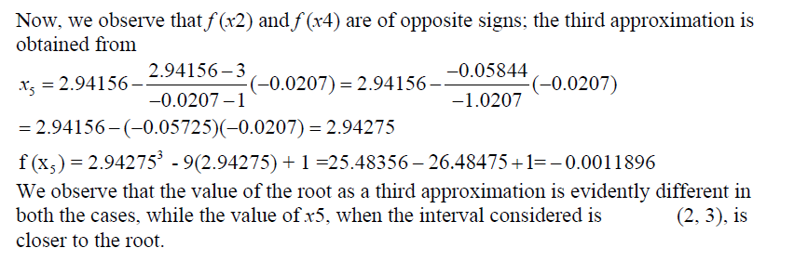

Slide 14
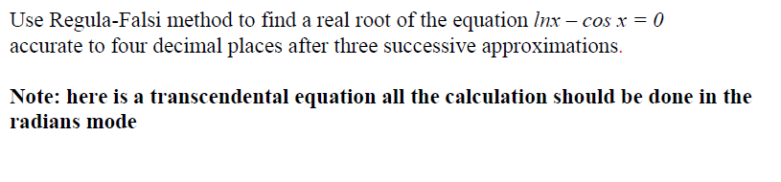
Example

Slide 15
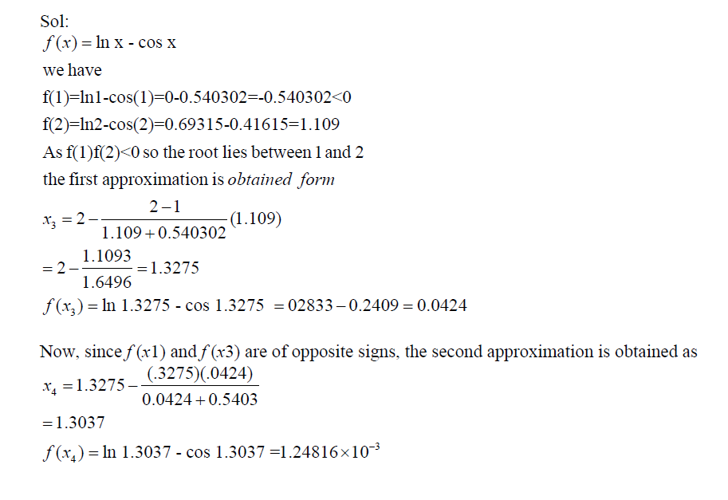
Example

Slide 16
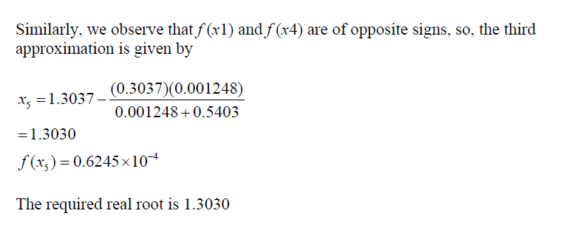

Slide 17
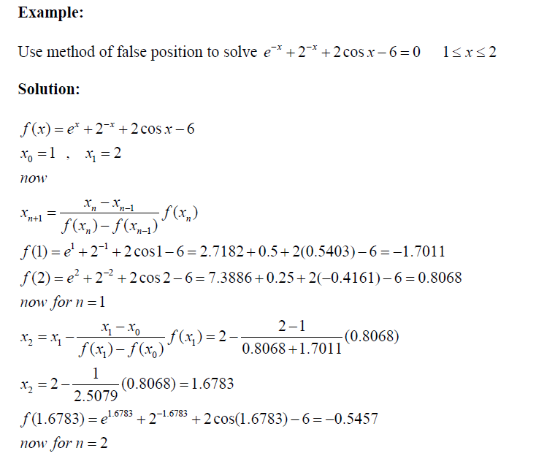

Slide 18
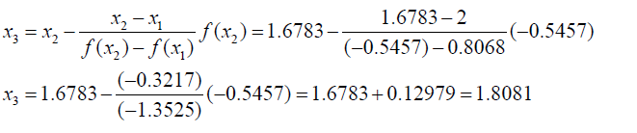
Example

Slide 19
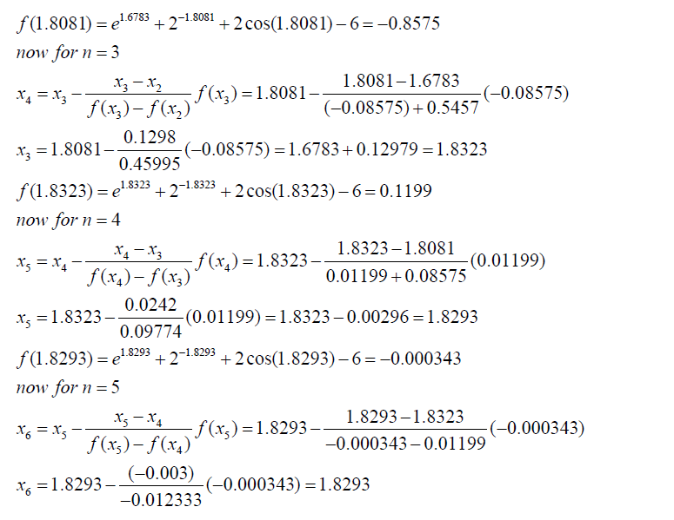

Slide 20
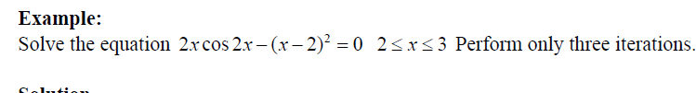

Slide 21
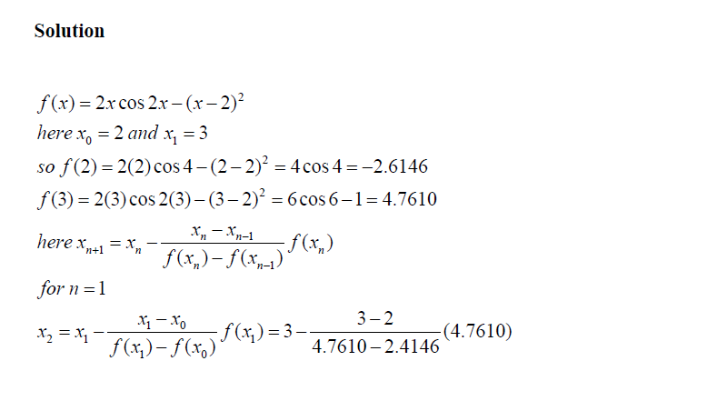

Slide 22
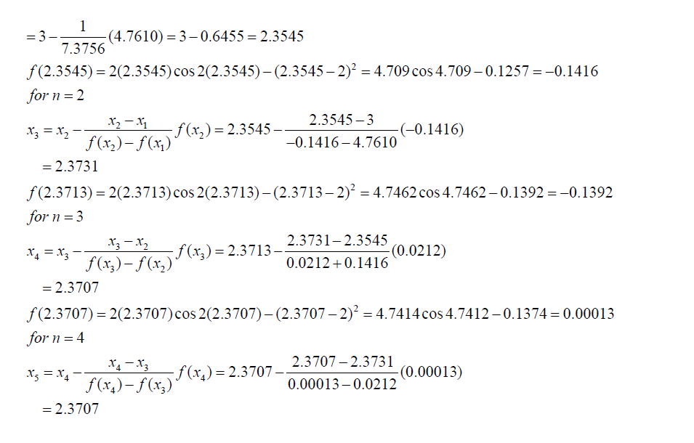

Slide 23

Example:
Solve for the root in the interval [1,2] by Regula-Falsi method:

Slide 24

Iteration no.
0 | 1.0000000000 | 2.0000000000 | 1.4782608747 | -2.2348976135
1 | 1.4782608747 | 2.0000000000 | 1.6198574305 | -0.5488323569
2 | 1.6198574305 | 2.0000000000 | 1.6517157555 | -0.1169833690
3 | 1.6517157555 | 2.0000000000 | 1.6583764553 | -0.0241659321
4 | 1.6583764553 | 2.0000000000 | 1.6597468853 | -0.0049594725
5 | 1.6597468853 | 2.0000000000 | 1.6600278616 | -0.0010169938
6 | 1.6600278616 | 2.0000000000 | 1.6600854397 | -0.0002089010
7 | 1.6600854397 | 2.0000000000 | 1.6600972414 | -0.0000432589
8 | 1.6600972414 | 2.0000000000 | 1.6600997448 | -0.0000081223

Slide 25
EXAMPLE: Consider f(x) = x³ + 3x – 5, where [ a = 1, b = 2 ] and error = 0.001.

Slide 26
i | a | x | b | f(a) | f(x) | f(b)
1 | 1 | 1.1 | 2 | – 1 | – 0.369 | 9
2 | 1.1 | 1.13544668587896 | 2 | – 0.369 | – 0.129797592130931 | 9
3 | 1.13544668587896 | 1.14773797024856 | 2 | – 0.129797592130931 | – 0.0448680509813286 | 9
4 | 1.14773797024856 | 1.15196570867269 | 2 | – 0.0448680509813286 | – 0.0154155863909917 | 9
5 | 1.15196570867269 | 1.15341577448 | 2 | – 0.0154155863909917 | – 0.0052852985292482 | 9
6 | 1.15341577448 | 1.15391264384212 | 2 | – 0.0052852985292482 | – 0.00181077883487646 | 9
7 | 1.15391264384212 | 1.15408284038531 | 2 | – 0.0018107788348764 | – 0.000620231485743084 | 9

